Slide 1
Structural Testing
SE401: Software Quality Assurance and Testing

Slide 2
Outline
Case Study - Airbus A320
Program Models and Graphs
White Box (Structural) Testing
Control Flow Coverage
Beyond Branch and Condition Testing
Path Testing
Cyclomatic Complexity
Java Code Coverage Tools
Summary

Slide 3
Case Study − Airbus A320

Slide 4


Case Study − Airbus A320
Launched in 1984
First civilian fly-by-wire computer system so advanced it can land plane virtually unassisted
No instrument dials – 6 CRTs
Notes:
4/10/2022
4

Slide 5

Case Study − Airbus A320 – Fatal Accidents
Air France Flight 296
Alsace, France, June 26, 1988
  The airplane software interpreted the low altitude/downed gear as "We're about to land”
  Would not allow the pilot to control the throttle.
  3 people died, 133 survived
Indian Airline Flight 605
Bangalore, India, February 14, 1990
  92 people died, 56 survived
Air Inter Flight 148
Mont Sainte Odile, January 20, 1992
  87 people died, 9 survived
Notes:
Indian Airlines A320 during final approach
Speed drops to dangerously low level causing rapid descent
A320 slams into a golf course just short of runway
Airbus A320 plows into pine forest, approach altitude reads 4700 feet on instruments
Height at impact: about 2500 feet

Slide 6
Case Study − Airbus A320: What Were the Causes?
The fly-by-wire system could ignore pilot actions.
Warning system alerts only seconds before accident.
  no time to react
Programmed landing maneuvers with bug in altitude calculation
  Altimeter showed the plane was higher than its actual altitude
Flight path angle and vertical speed indicator have the same display format
  confuses pilots
Note:
In vertical speed mode "-3.3" means a descent rate of 3300 feet/min.
In TRK/FPA (track/flight path angle) mode this would have meant a (correct) -3.3 deg descent angle.

Slide 7
Program Models and Graphs

Slide 8
Properties of Models
Compact:
  representation of a system
Predictive:
  represent some salient characteristics
  well enough to distinguish between good and bad
  no single model represents all characteristics
Semantically meaningful:
  permits diagnosis of the causes of failure
Sufficiently general:
  general enough for practical use
Notes:
8

Slide 9
Graph Representations: directed graphs
Directed graph:
  N (set of nodes)
  E (relation on the set of nodes ) edges
Nodes: {a, b, c}
Edges: {(a,b), (a, c), (c, a)}
a
b
a
c
b
c

Slide 10
Graph Representations: labels and code
We can label nodes with the names or descriptions of the entities they represent.
  If nodes a and b represent program regions containing assignment statements, we might draw the two nodes and an edge (a,b) connecting them in this way:
x = y + z;
a = f(x);

Slide 11
Multidimensional Graph Representations
Sometimes we draw a single diagram to represent more than one directed graph, drawing the shared nodes only once
  class B extends (is a subclass of) class A
  class B has a field that is an object of type C
extends relation
NODES = {A, B, C}
EDGES = {(A,B)}
includes relation
NODES = {A, B, C}
EDGES = {(B,C)}
a
b
c

Slide 12
Example of Control Flow Graph
public static String collapseNewlines(String argStr)
{
char last = argStr.charAt(0);
StringBuffer argBuf = new StringBuffer();
for (int cIdx = 0 ; cIdx < argStr.length(); cIdx++)
{
char ch = argStr.charAt(cIdx);
if (ch != '\n' || last != '\n')
{
argBuf.append(ch);
last = ch;
}
}
return argBuf.toString();
}

Slide 13
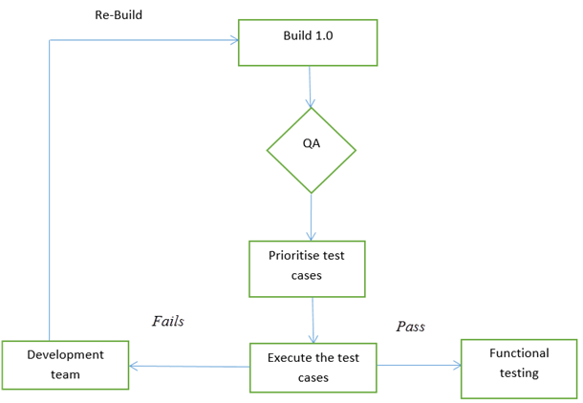
Flowchart
Testers usually use flowcharts in the test plan, test strategy, requirements artifacts or other process documents.
Here are two ways we testers use flow charts:
  Flowcharts for control flow and statistical analysis
  Flow charts for process illustration

Slide 14
Control Flow Graph (CFG)
Intra-procedural control flow graph
Nodes = regions of source code, basic blocks
  maximal program region with a single entry and single exit
    Statements are grouped in single block
    Single statement can also be broken into multiple nodes
Directed edges = control flow
  program execution may proceed from one node to another

Slide 15
White Box Testing a.k.a. Structural Testing

Slide 16
Structural Testing
Judging the thoroughness of a test suite based on the structure of the program
Compare to functional (requirements based, black-box) testing
  Structural testing is still testing product functionality against its specification.
  Only the measure of thoroughness has changed.
Usually done by the programmers as part of unit testing

Slide 17
Why Structural Testing?
“What is missing in our test suite?”
If part of a program is not executed by any test case in the suite, defects in that part cannot be exposed.
What is a “part”?
  Typically, a control flow element or combination:
    Statements (or CFG nodes), branches (or CFG edges)
    Fragments and combinations: conditions, paths
Complements functional testing:
  Another way to recognize cases that are treated differently
Notes:
The fundamental rationale for any systematic (non-random) testing technique is
variation: Testing something different is more valuable than testing the same
thing again. There are many ways to consider “same” and “different”, and we
find value in any sense of “different” that might reveal faults that were not
revealed by other test cases. Functional testing uses the program specification
to say what is “different” (systematically covering cases that can be identified
in the specification). Structural testing

Slide 18
Structural Testing
Structural testing techniques serve two purposes:
  Test coverage measurement
    We can assess the amount of testing performed by tests derived from e.g. specification-based technique to asses coverage.
  Structural test case design
    We can generate additional test cases with the aim of increasing the test coverage.

Slide 19
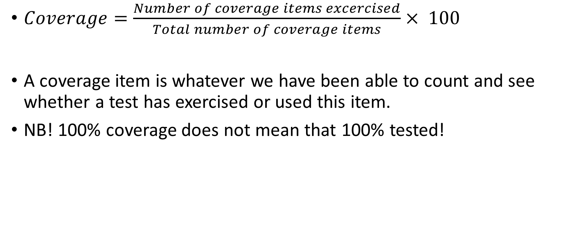
What is coverage?
$Coverage=\frac{Number of coverage items excercised}{Total number of coverage items}× 100$
A coverage item is whatever we have been able to count and see whether a test has exercised or used this item.
NB! 100% coverage does not mean that 100% tested!

Slide 20
Structural Coverage Testing
Idea
  Code that has never been executed likely has bugs
    At least the test suite is clearly not complete
This leads to the notion of code coverage
  Divide a program into elements (e.g., statements)
  Define the coverage of a test suite to be

Slide 21
Control Flow Graphs: The One Slide Tutorial
X = 3; if (B > 0)
Y = 0;
else
Y = Z + W; A = 2 * 3;
X = 3
B > 0
Y = Z + W
Y = 0
A = 2 * 3
A graph
Nodes are basic blocks
  statements
Edges are transfers of control between basic blocks

Slide 22
Test Adequacy Criterion
Adequacy criterion of a test suite
  Whether a test suite satisfies some property deemed important to thoroughly test a program
e.g.,
  Cover all statements
  Cover all branches

Slide 23
Control Flow Based Adequacy Criteria and Coverage
Statement coverage
  Cover every statement at least once
Branch coverage, a.k.a. decision coverage
  Cover every branch at least once
(Basic) Condition coverage
  Cover each outcome of every condition
Branch-Condition coverage
  Cover all conditions and all branches
Modified condition decision coverage (MC/DC)
Compound condition coverage
  Cover all possible combinations of every condition

Slide 24
A Simple Example of Coverage
  if ( a < b and c == 5) {
    y++;
  }
  x = 5;
Test cases:
(a) a < b, c == 5
(b) a < b, c != 5
(c) a >= b, c == 5
(d) a >= b, c != 5
Statement coverage:
  Test case (a)
Branch coverage:
  Test cases (a) and (b)
(Basic) Condition coverage:
  Test case (b) and (c)
  Problem: and (&&) short circuits! And second half of (c) not executed.
Branch-Condition coverage:
  Test case (a) (b) and (c)
Compound condition coverage:
  Test case (a) (b) (c) and (d)
* and is interpreted as logical-and

Slide 25
Statement Testing
Adequacy criterion:
  each statement (or node in the CFG) must be executed at least once
Coverage:
# executed statements
# statements
Rationale:
  A defect in a statement can only be revealed by executing the faulty statement
Notes:
12.2 STATEMENT TESTING

Slide 26
Statements or Blocks?
Nodes in a CFG often represent basic blocks of multiple statements
  basic block coverage or node coverage
  difference in granularity, not in concept
No essential difference
  100% node coverage ⇔ 100% statement coverage
    but levels will differ below 100%
  A test case that improves one will improve the other
    though not by the same amount, in general

Slide 27
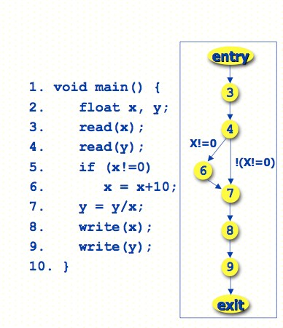
Statement Coverage: Example
Test requirements
– Nodes 3, …, 9
Test cases
– (x = 20, y = 30)
Any problems with this example?

Slide 28
Statement Coverage: Example
Test requirements
– Nodes 3, …, 9
Test cases
– (x = 20, y = 30)
Such test does not reveal the fault at statement 7
To reveal it, we need to traverse edge 4-7
=> Branch Coverage

Slide 29
Statement Coverage in Practice
Microsoft reports 80-90% statement coverage
Boeing must get 100% statement coverage (feasible) for all software
Usually can about 85% coverage; 100% is harder
  Unreachable code; dead code
  Complex sequences
  Not enough resources

Slide 30
Branch Testing
Adequacy criterion:
  each branch (edge in the CFG) of every selection statement (if, switch) must be executed at least once
Coverage:
# executed branches
# branches

Slide 31
Statements vs. Branches
Traversing all edges of a graph causes all nodes to be visited
  Satisfying branch adequacy implying satisfying the statement adequacy
The converse is not true
  A statement-adequate (or node-adequate) test suite may not be branch-adequate (edge-adequate)

Slide 32
Branch Coverage: Example
Test requirements
– Edges 4-6, Edges 4-7
Test cases
– (x = 20, y = 30)
– (x = 0, y = 30)

Slide 33
Branch Coverage: Example
1. main() {
2.
3.
4.
5.
6.
7.
8.
9.
10.
11.
12.
int x, y, z, w;
read(x);
read(y);
if (x != 0)
z = x + 10;
else
z = 0;
if (y>0)
w = y / z;
Branch Coverage
Test Cases
– (x = 1, y = 22)
– (x = 0, y = -10)
Is the test suite adequate for branch coverage?
}

Slide 34
Branch Coverage: Example
1. main() {
Branch Coverage
Test Cases
– (x = 1, y = 22)
– (x = 0, y = -10)
2.
3.
4.
5.
6.
7.
8.
9.
10.
11.
12.
int x, y, z, w;
read(x);
read(y);
if (x != 0)
z = x + 10;
else
z = 0;
if (y>0)
w = y / z;
Is the test suite adequate for branch coverage?
Yes, but it does not reveal the fault at statement 10
Test case (x = 0, y = 22)
  Reveals fault
}

Slide 35
Branch Coverage: Example
Consider test cases
  {(x=5,y=5), (x=5, y=-5)}
The test suite is adequate for branch coverage, but does not reveal the fault at statement 6
Predicate 4 can be true or false operating on only one condition
⇒ Basic condition coverage

Slide 36
(Basic) Condition Testing
Adequacy criterion:
  Both outcomes (true and false) of each basic condition or predicate, must be tested at least once
  Basic condition or predicate: a Boolean expression that does not contain other Boolean expression
Coverage:
# truth values taken by all basic conditions
2 * # basic conditions
[See note]
Notes:
the total number of truth values that the basic conditions can take is twice the number of basic conditions, since each basic condition can assume value true or false

Slide 37
Basic Condition Coverage: Example
Consider test cases
  {(x=5,y=5), (x=5, y=-5)}
The test suite is adequate for basic condition coverage, but it does not reveal the fault at statement 6
The test suite is not adequate for branch coverage.
⇒Branch and condition coverage

Slide 38
Branch-Condition Testing
Branch and condition adequacy
Cover all conditions and all branches
  Both outcomes (true and false) of each basic condition must be tested at least once.
  All branches of every selection statement must be executed at least once .
Notice that due to the left-to-right evaluation order and short-circuit evaluation of logical OR expressions, the value true for the first condition does not need to be combined with both values false and true for the second condition.
Notes:
Notice that due to the left-to-right evaluation order and short-circuit evaluation of logical OR expressions in the C language, the value true for the first condition does not need to be combined with both values false and true for the second condition.

Slide 39
Compound Condition Testing
Compound (multiple) condition adequacy:
  Cover all possible combinations of compound conditions and cover all branches of a selection statement
  For a compound condition with
  n basic conditions,
  2^{n} test cases may be needed.
 | C1 | C2 | C
T1 | T | T | T
T2 | T | F | F
T3 | F | T | F
T4 | F | F | F
C = C1 and C2
Notes:
Notice that due to the left-to-right evaluation order and short-circuit evaluation of logical OR expressions in the C language, the value true for the first condition does not need to be combined with both values false and true for the second condition.

Slide 40
Compound Conditions: Exponential Complexity
(((a || b) && c) || d) && e
Test Case a b c d e
(1) T — T — T
(2) F T T — T
(3) T — F T T
(4) F T F T T
(5) F F — T T
(6) T — T — F
(7) F T T — F
(8) T — F T F
(9) F T F T F
(10) F F — T F
(11) T — F F —
(12) F T F F —
(13) F F — F —
short-circuit evaluation often reduces this to a more manageable number, but not always
Notes:
Why do we care? Because even one very complex condition in a program could require
an impractical number of test cases. For example, a condition with 16 basic conditions
could require more than 32,000 test cases (although this is unlikely in practice, because
very large conditions are more typically just one big disjunction or one big conjunction,
which are effectively reduced to a linear number of cases by short-circuit evaluation).

Slide 41
Modified Condition/Decision Coverage (MC/DC)
Motivation:
  Effectively test important combinations of conditions, without exponential blowup in test suite size
  “Important” combinations means:
    each basic condition shown to independently affect the outcome of each decision
Requires: For each basic condition C, two test cases,
  C evaluates to true for one and false for the other
  Values of all other evaluated conditions remain the same
  The compound condition as a whole evaluates to true for one and false for the other
Notes:
If we don't want to test all possible combinations, then we have to say which combinations are important.
One good choice is to choose combinations that show how each basic condition can affect the outcome,
i.e., how changing that one condition can change the value of the whole compound condition. That's
what the “modified condition/decision” criterion requires.

Slide 42
Construct Test Cases for MC/DC
MC/DC with two basic conditions
  C = C1 && C2
  C = C1 || C2
 | C1 | C2 | C
T1 | T | T | T
T2 | T | F | F
T3 | F | T | F
 | C1 | C2 | C
T1 | T | F | T
T2 | F | T | T
T3 | F | F | F

Slide 43
Construct Test Cases for MC/DC
MC/DC with three basic conditions
  C = (C1 && C2)&& C3
  Copy rows T1, T2, T3 in the (C1 && C2) table to the table below and
  Fill in true for column C3
  Operator || can be handled similarly (symmetric)
 | C1 | C2 | C3 | C
T1 | T | T | T | T
T2 | T | F | T | F
T3 | F | T | T | F
T4

Slide 44
Construct Test Cases for MC/DC
MC/DC with three basic conditions
  C = (C1 && C2) && C3
  Add a new row for T4
    Column C3: false
    Column C1 and C2: copy the values from one of T1, T2, or T3 with true outcome
 | C1 | C2 | C3 | C
T1 | T | T | T | T
T2 | T | F | T | F
T3 | F | T | T | F
T4 | T | T | F | F

Slide 45
MC/DC: Linear Complexity
Only n+1 test cases needed for n basic conditions
Adopted by many industry quality standards
(((a || b) && c) || d) && e
Test Case a b c d e Outcome
(1) true -- true -- true true
(2) false true true -- true true
(3) true -- false true true true
(6) true -- true -- false false
(11) true -- false false -- false
(13) false false -- false -- false
  Values in red independently affect the output of the decision
Notes:
This is the same table as two slides ago, omitting redundant cases.
Cases 4,5, 7-10, and 12 have been omitted.
In each column we find two rows in which that column is underlined. For example, the “a” column is underlined in rows (1) and (13). All the evaluated conditions in those two rows are the same except for that column. For example, to show that changing “a” from true to false in case (1) would change the outcome, we
* Fill in the “don't care” columns in row 1 with values from row 13 (because this doesn't change anything
* Then see that the rows are completely identical except in column “a” and the outcome so clearly changing the value of “a” changed the outcome.
The number of test cases needed is hardly more than for basic condition coverage, but MC/DC is much better than basic condition coverage at exposing faults in conditional expressions, so it is clearly superior (and therefore very widely used, and specified in some standards).

Slide 46
Analysis of MC/DC
MC/DC is
  basic condition coverage (C)
  decision (branch) coverage (DC)
  plus one additional condition (M):
  every condition must independently affect the decision's outcome
Subsumed by compound conditions
Subsumes all other criteria discussed so far
  stronger than statement and branch coverage
A good balance of thoroughness and test size
  therefore widely used
Notes:
(This mainly restates comments on the previous slide, and can be used
or skipped depending on lecture style)

Slide 47
Leave (Almost) No Code Untested
In general
  90% coverage is achievable
  95% coverage require significant effort
  100% not always attainable
Challenges in coverage
  Platform specific code
  Defensive programming
  Exception handling
  Non-public method, never invoked

Slide 48
Summary
Rationale for structural testing
Basic terms: adequacy, coverage
Characteristics of common structural criteria
  Statement, branch, condition, compound condition, MC/DC
Practical uses and limitations of structural testing

Slide 49
Path Testing

Slide 50
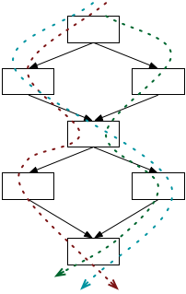
Paths Testing
Beyond individual branches.
Should we explore sequences of branches (paths) in the control flow?
Many more paths than branches
  A pragmatic compromise will be needed

Slide 51
Path Coverage
Path coverage means that all possible execution paths in the program must be executed.
This is a very strong coverage criterion, but impractical.
Programs with loops have an infinite number of execution paths, and thus would need an infinite number of test cases
The fact that there is complete branch coverage does not mean that all errors will be found. Branch testing does not necessarily check all combinations of control transfers.

Slide 52
Path Adequacy
Decision and condition adequacy
  Test individual program decisions
Paths testing
  Test combinations of decisions along paths
Adequacy criterion:
  Each path must be executed at least once
Coverage:
# executed paths
# total paths
Notes:
12.5 PATH TESTING
Path coverage simply requires each path to be executed at least once, thus helping in revealing failures that occur when loops are executed several times. Unfortunately, “pure” path coverage is impractical even for simple programs (the program on the slide has infinite many paths). An easy way to reduce the number of paths is to limit the number of times of executions of each loop.

Slide 53
Practical Path Coverage Criteria
The number of paths in a program with loops is unbounded
  the simple criterion is impossible to satisfy
For a feasible criterion:
  Partition infinite set of paths into a finite number of classes
Useful criteria can be obtained by limiting
  the number of traversals of loops
  the length of the paths to be traversed
  the dependencies among selected paths
Notes:
PATH TESTING
Path coverage simply requires each path to be executed at least once, thus helping in revealing failures that occur when loops are executed several times. Unfortunately, “pure” path coverage is impractical even for simple programs with loops. To ensure a finite number of paths, we must at least limit the number of times of executions of each loop (e.g., lump “5 iterations” and “105 iterations” in the same class “more than 1 iteration”, requiring only one representative execution from that class).

Slide 54
Boundary Interior Path Testing
Group together paths that differ only in the sub-path they follow when repeating the body of a loop
Follow each path in the control flow graph up to the first repeated node
The set of paths from the root of the tree to each leaf is the required set of sub-paths for boundary/interior coverage

Slide 55
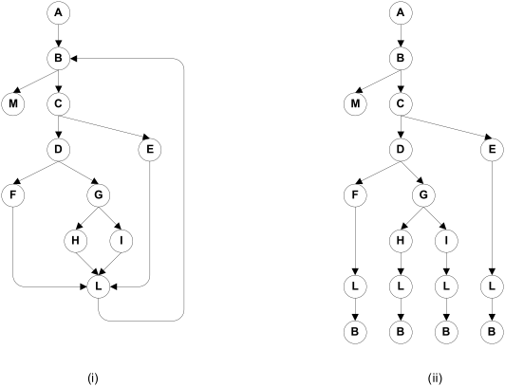
Boundary Interior Adequacy for cgi-decode
Notes:
The graph at the right shows the paths that must be covered in the control flow graph at the left, using the “boundary interior”
adequacy criiterion.

Slide 56
Limitations of Boundary Interior Adequacy
The number of paths can still grow exponentially
if (a) {
S1;
}
if (b) {
S2;
}
if (c) {
S3;
}
...
if (x) {
Sn;
}
The sub-paths through this control flow can include or exclude each of the statements Si
Total N branches result in 2^{N} paths that must be traversed
Choosing input data to force execution of one particular path may be very difficult
  even impossible if the conditions are not independent

Slide 57
Loop Boundary Adequacy
A test suite satisfies the loop boundary adequacy criterion iff for every loop:
  At least one test case: the loop body is iterated zero times
  At least one test case: the loop body is iterated once
  At least one test case: the loop body is iterated more than once

Slide 58
What is LCSAJ Testing ?
LCSAJ stands for Linear Code Sequence and Jump, a white box testing technique to identify the code coverage, which begins at the start of the program or branch and ends at the end of the program or the branch.
LCSAJ consists of testing and is equivalent to statement coverage.
LCSAJ Characteristics:
  100% LCSAJ means 100% Statement Coverage
  100% LCSAJ means 100% Branch Coverage
  100% procedure or Function call Coverage
  100% Multiple condition Coverage

Slide 59
Linear Code Sequence and Jump (LCSAJ)
Execution of sequential programs that contain at least one condition, proceeds in pairs where the first element of the pair is a sequence of statements, executed one after the other, and terminated by a jump to the next such pair.
A Linear Code Sequence and Jump is a program unit comprised of a textual code sequence that terminates in a jump to the beginning of another code sequence and jump.
An LCSAJ is represented as a triple (X, Y, Z) where X and Y are, respectively, locations of the first and the last statements and Z is the location to which the statement at Y jumps.

Slide 60
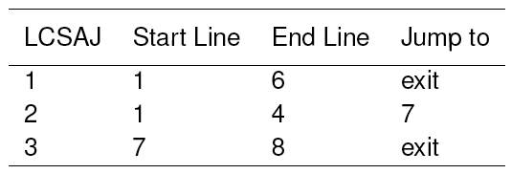
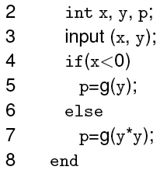
Linear Code Sequence and Jump (LCSAJ)
Consider this program.
The last statement in an LCSAJ (X, Y, Z) is a jump and Z may be program exit. When control arrives at statement X, follows through to statement Y, and then jumps to statement Z, we say that the LCSAJ (X, Y, Z) is traversed or covered or exercised.

Slide 61
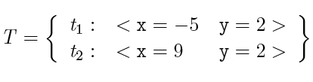
LCSAJ coverage: Example 1
t2 covers (1,4,7) and (7, 8, exit).
t1 covers (1, 6, exit).
T covers all three LCSAJs.

Slide 62
Basis Path Testing
First proposed by Tom McCabe in 1976. Later expanded it into Cyclomatic Complexity.
Enables the test case designer to derive a logical complexity measure of the procedural design.
Uses this measure as the basis for defining an upper bound on the number of execution paths needed to guarantee that every statement in the program is executed at least once.
Uses a notation known as a flow graph.
  Each structured notation has a corresponding flow graph symbol.

Slide 63
Flow Graph Notation
Sequence
if
Case
until
while
Where each circle represents one or more nonbranching set of source code statements.

Slide 64
Flow chart and corresponding flow graph
1
1
2,3
R₁
2
6
R₂
3
7
R₄
8
4,5
9
6
4
7
8
5
R₃
10
9
10
11
R = Regions
11

Slide 65
Compound logic
A compound condition occurs when one or more Boolean operators (logical OR, AND, NAND, NOR) is present in a conditional statement.
Example:
if a OR b
then do X
else do Y
endif
a
a
b
x
b
y
x
y
x

Slide 66
Independent Program Paths
Any path through the program that introduces at least one new set of processing statements or a new condition.
In terms of a flow graph, an independent path must move along at least one edge that has not previously been traversed.

Slide 67
Basis Paths Example
Basis paths:
Path 1: 1-11
Path 2: 1-2-3-4-5-10-1-11
Path 3: 1-2-3-6-8-9-10-1-11
Path 4: 1-2-3-6-7-9-10-1-11
The path below is NOT a basis path 1-2-3-4-5-10-1-2-3-6-8-9-10-1-11 because it does not traverse any new edges.
1
2
3
6
4
7
8
5
9
10
11

Slide 68
Choose a Set of Basis Paths
Traverse the CFG to identify basis paths
  Each path contains at least one edge that is not in other paths.
  No iteration of sub-paths
There is more than one set of basis paths for a given CFG.

Slide 69
Basis Paths
These paths constitute a basis set for the flow graph.
Design tests to execute these paths.
Guarantees:
  Every statement has been executed at least once.
  Every condition has been executed on both its true and false sides.
There is more than ONE correct set of basis paths for a given problem.
How many paths should we look for?
  Calculate Cyclomatic complexity V(G)
    V(G) = E-N+2
    V(G) = P + 1 (Where P = number of predicate nodes)
    V(G) = R (Where R = number of regions)

Slide 70
Cyclomatic Complexity (CC)
Evaluates the complexity of an algorithm in a method. It measures the number of linearly independent paths through a program's source code
Three equivalent definitions
  V(G) = E-N+2
    Or given a flow graph: = edges – nodes + 2
  V(G) = P + 1 (Where P = number of predicate nodes)
    Defined to be one larger than the number of decision points (if/case-statements, while-statements, etc.) in a module (function, procedure, chart node, etc.).
      Note that in an if or while statement, a complex boolean counts each part, (e.g. if( a<b and c>0) counts as two decision points.
  V(G) = R (Where R = number of regions)
Notes:
http://satc.gsfc.nasa.gov/support/STC_APR98/apply_oo/apply_oo.html

Slide 71
Cyclomatic Complexity (CC)
Calculate the cyclomatic complexity.
A method with a low cyclomatic complexity is generally better.
This may imply decreased testing and increased understandability or that decisions are deferred through message passing, not that the method is not complex
Notes:
http://satc.gsfc.nasa.gov/support/STC_APR98/apply_oo/apply_oo.html

Slide 72
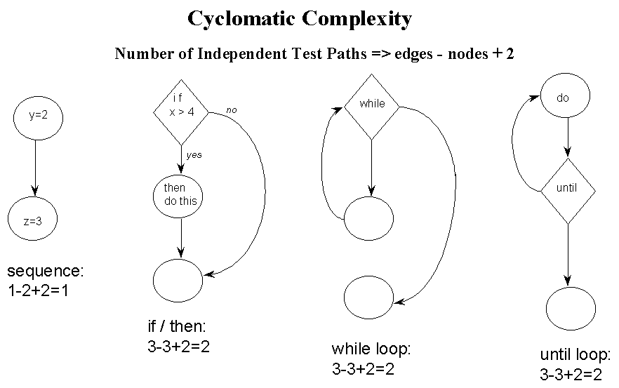
Cyclomatic Complexity (CC)
CC = edges – nodes + 2
Notes:
http://satc.gsfc.nasa.gov/support/STC_APR98/apply_oo/apply_oo.html

Slide 73
Cyclomatic Testing
A compromise between path testing and branch-condition testing
Cyclomatic testing, a.k.a., basis path testing
  Test all of the independent paths that could be used to construct any arbitrary path through the computer program
Steps:
  1. Calculate Cyclomatic complexity
  2. Choose a set of basis paths
  3. Design test cases to exercise each basis path

Slide 74
Cyclomatic Complexity (McCabe)
  A set of basis paths in a CFG
  Each path contains at least one edge that is not in other paths
  No iteration of sub-paths
The number of basis paths in a CFG is known as the Cyclomatic Complexity of the CFG
Calculate Cyclomatic complexity of CFG G
  e = #edges in G
  n = #nodes in G
The cyclomatic complexity of G
  V(G) = e - n + 2

Slide 75
Cyclomatic Complexity (McCabe)
If a CFG has a single entry and single exit point,
  the calculation of the cyclomatic complexity can be simplified
V(G) = #predicates + 1
Rules for counting predicates in CFG
  Condition in a if-statement: count each predicate
  Condition in a loop statement count as 1, even if it's a compound condition
  Switch statement: n-way choice count as (n -1)

Slide 76
Cyclomatic Complexity Examples
statement₁
statement₂
…
statement_{n}
if (x > 5) {
statement₁
}
if (x > 5) {
statement₁
} else {
statement₂
}
V(G) = 2
V(G) = 1
V(G) = 2

Slide 77
Cyclomatic Complexity Examples
switch (exp) {
case v₁: statement₁; break;
case v₂: statement₂; break;
…
case v_{n}: statement_{n}; break;
default: statement_{n+1};
}
if (x > 5 || x <= 10) {
statement₁
}
if (x >= 0 && x <= 100) {
statement₁
} else if (x <= 30) {
statement₁
} else {
statement₂
}

Slide 78
Cyclomatic Complexity Examples
switch (exp) {
case v₁: statement₁; break;
case v₂: statement₂; break;
…
case v_{n}: statement_{n}; break;
default: statement_{n+1};
}
if (x > 5 || x <= 10) {
statement₁
}
if (x >= 0 && x <= 100) {
statement₁
} else if (x <= 30) {
statement₁
} else {
statement₂
}
V(G) = 3
V(G) = n + 1
V(G) = 4

Slide 79
Cyclomatic Complexity Examples
while (i < 100) {
statement₁;
}
while (i < 100 && a != null) {
statement₁;
}
for (i = 0; i < 10; i++) {
statement₁
}
for (i = 0; i <= 10 || j == 0;
i++) {
statement₁;
if (i > 5 || i <= 10) {
statement₂
}
}

Slide 80
Cyclomatic Complexity Examples
while (i < 100) {
statement₁;
}
while (i < 100 && a != null) {
statement₁;
}
for (i = 0; i < 10; i++) {
statement₁
}
for (i = 0; i <= 10 || j == 0;
i++) {
statement₁;
if (i > 5 || i <= 10) {
statement₂
}
}
V(G) = 2
V(G) = 2
V(G) = 2
V(G) = 4

Slide 81
Cyclomatic Adequacy and Coverage
Cyclomatic adequacy criterion
  Each basis path must be executed at least once
  Guarantees:
    Every statement has been executed at least once.
    Every condition has been executed on both its true and false sides.
  Recommended by NIST as a baseline technique
Cyclomatic coverage
  the number of basis paths that have been executed, relative to cyclomatic complexity
# executed basis paths
cyclomatic complexity
Notes:
There is nothing deep to be grasped here about linearly independent paths, but cyclomatic complexity is used in industry for test planning (estimating testing effort) and sometimes as an adequacy measure. Its attractions are that cyclomatic complexity serves as a simple, rough estimate of the complexity of code, and it requires more testing effort for code with complex control flow than for code with simple control flow. “Linear independence” requires some differences between test cases that can be counted toward thorough testing, even if it is not closely related to the programmer's case analysis.

Slide 82
An Example:
Float Function CalculateFees ( String mgroup, Integer mAge, Float mBaseFees, Integer mFamilyCount, Integer mMinFee)
/* How many months left in the year */
1 MonthsLeft = 12 – GetMonth(SystemDate())
/* Calculate base rate for the group */
2 if mgroup == 1 then
3 mRate = mBaseFees
4 else
5 if mgroup == 2 then
6 mRate = mBaseFees * 0.80
7 else
8 mRate = mBaseFees * 0.65
9 endif
10 endif
11 mBaseFees = mRate * MonthsLeft
12 while mFamilyCount > 1 and mBaseFees > mMinFee
13 if mAge >= 21
14 mBaseFees = mBaseFees – 10
15 else
16 mBaseFees = mBaseFees – 5
17 endif
18 mFamilyCount = mFamilyCount – 1
19 endwhile
20 return mBaseFees

Slide 83
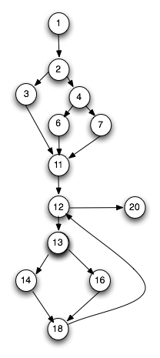
Steps for deriving test cases
Determine a basis set of linearly independent paths.
1-2-3-11-12-20
1-2-4-6-11-12-20
1-2-4-7-11-12-20
1-2-3-11-12-13-14-18-12-20
1-2-4-6-11-12-13-14-18-12-20
1-2-4-7-11-12-13-14-18-12-20
1-2-3-11-12-13-16-18-12-20
1-2-4-6-11-12-13-16-18-12-20
1-2-4-7-11-12-13-16-18-12-20
Prepare test cases that will force execution of each path in the basis set.

Slide 84
Infeasible Paths
Some paths are infeasible…
begin
1. readln (a);
2. if a > 15
then
3. b:=b+1;
else
c:=c+1;
if a < 10
then
6. d:=d+1;
7. end
V(G) = 3:
There are three basis paths:
Path 1: 1,2,3,5,7
Path 2: 1,2,4,5,7
Path 3: 1,2,3,5,6,7
Which of these paths is non-executable and why?

Slide 85
Comparing Criteria
Can we distinguish stronger from weaker adequacy criteria?
Empirical approach:
  Study the effectiveness of different approaches to testing in industrial practice
  What we really care about, but ...
  Depends on the setting; may not generalize from one organization or project to another
Analytical approach:
  Describe conditions under which one adequacy criterion is provably stronger than another
  Stronger = gives stronger guarantees
  One piece of the overall “effectiveness” question

Slide 86
The Subsumes Relationship
The subsumption relationship means that satisfying one test coverage criterion may implicitly force another test coverage criterion to be satisfied as well
  E.g.: Branch coverage forces statement coverage to be attained as well (This is strict subsumption)
“Subsumes” does not necessarily mean “better”

Slide 87
The Subsumes Relationship
Test adequacy criterion A subsumes test adequacy criterion B iff, for every program P, every test suite satisfying A with respect to P also satisfies B with respect to P.
Example:
  Exercising all program branches (branch coverage) subsumes exercising all program statements
A common analytical comparison of closely related criteria
  Useful for working from easier to harder levels of coverage, but not a direct indication of quality

Slide 88
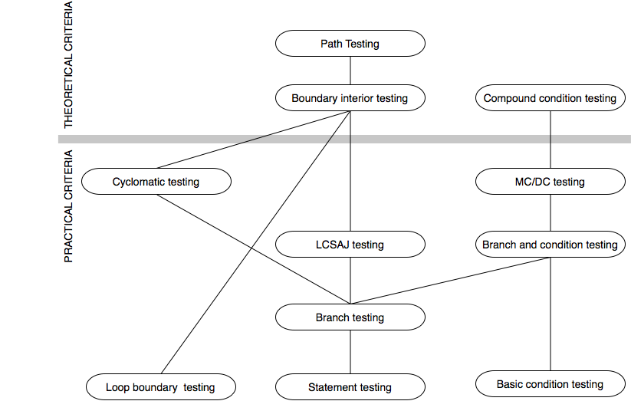
The Subsumes Relation among Structural Testing Criteria
Notes:
NOTE: This diagram is revised (corrected) from the version that appears in the book --- the position of “loop boundary testing” has been changed to properly reflect the definition
given in the book.
The criteria above the bar are of theoretical interest, but can require either an exponential number of test cases relative to program size (compound condition testing, boundary interior testing) or a
potentially infinite number of test cases (path testing). The criteria below the bar are “practical” in the sense that the number of test cases they require, even in the worst case, is only linear in
program size, and all of them have been used in industrial practice.
Since MC/DC and loop boundary testing are mutually incomparable, and since each is closely tied to program logic (reflecting the case analysis that a programmer must consider to write and justify the code), they are an attractive combination.

Slide 89
Satisfying Structural Criteria
Sometimes criteria may not be satisfiable
The criterion requires execution of
  statements that cannot be executed as a result of
    defensive programming
    code reuse (reusing code that is more general than strictly required for the application)
  conditions that cannot be satisfied as a result of
    interdependent conditions
  paths that cannot be executed as a result of
    interdependent decisions
Notes:
12.8 THE INFEASIBILITY PROBLEM

Slide 90
Satisfying Structural Criteria
Large amounts of fossil code may indicate serious maintainability problems
  But some unreachable code is common even in well-designed, well-maintained systems
Solutions:
  make allowances by setting a coverage goal less than 100%
  require justification of elements left uncovered
    RTCA-DO-178B and EUROCAE ED-12B for modified MC/DC
Notes:
12.8 THE INFEASIBILITY PROBLEM

Slide 91
Java Code Coverage Tools
Emma
Clover
Cobertura
JaCoCo
JCov
Serenity
See:
https://en.wikipedia.org/wiki/Java_Code_Coverage_Tools

Slide 92
Summary
Basis path testing should be applied to critical modules
Adequacy criteria and coverage
  statement
  branch
  condition, branch-condition, compound condition
  MC/DC
  paths
  boundary/interior
  loop boundary
  LCSAJ
  Cyclomatic, basis path
Full coverage is usually unattainable

